Slide 1
COLLABORATIVE FILTERING ALGORITHM
Present by:
NAMES AND MATRIC NOS

Slide 2
Contents
Contents
CHAPTER ONE
INTRODUCTION
Statement of Problems
Aim and Objective of the Study
CHAPTER TWO
LITERATURE REVIEW
Filtering Algorithm/ Recommender
Collaborative Filtering Algorithm
CHAPTER THREE
METHODOLOGY
Application Designed

Slide 3
Introduction
collaborative filtering is a technique that recommends items based on the opinions of other users.
They use information about users, user profiles, to predict the utility or relevance of a particular item, thus providing personalized recommendations.
Filter algorithm base systems have proven to be useful in contexts such as e-commerce, e-health and they surely have a promising future in many other domains, like Web search engines, digital TV program recommenders, etc.

Slide 4
Statement of the Problem
Text data is ubiquitous. Management of string data in databases and information systems has taken on particular importance recently. Compare to the old days where accessing to information was time consuming and hectic with less or zero result after a lot of effort has been made. Initially searching for information or data among string of information might take hours, days, if not months. Search engine was one break through that announces the internet for what it is today, while filtering the contents and every part and details of search result is as important as the search engine itself. Although several attempts has been made to cater for this by developing a system that can tackle this issue, but they are unreliable, inconsistent, error prone and most time redundancy make them fall below expectation.

Slide 5
Aim and Objectives of the Study
Aim
To develop a system that helps filter unnecessary data from ambiguous set of data, which lead to the design of Collaborative Filtering System.
Objectives
To integrate Collaborative Filtering into information service.
To develop an application that help users to get accurate information by reducing the rate of unnecessary data.
To develop an application that helps in optimizes among several form of alternatives using collaborative filtering algorithm.

Slide 6
Literature Review
Personalization of product information has become one of the most important factors that impact a customer's product selection and satisfaction in today's competitive and challenging market.
Personalized service requires firms to understand customers and offer goods or services that meet their needs.
Successful firms are those provide the right products to the right customers at the right time and for the right price
Recommendation systems are decision aids that analyze customer's prior online behavior and present information on products to match customer's preferences. Through analyzing the customer's purchase history or communicating with them, recommendation systems employ quantitative and qualitative methods to discover the products that best suit the customer

Slide 7
Filtering Algorithm
Filtering Algorithm systems are defined as recommendation inputs given by the people, which the system then aggregates and directs to appropriate recipients.
It is system that produces individualized recommendations as output or has the effect of guiding the user in a personalized way to interesting objects in a larger space of possible options
Types
Collaborative Recommender system
Content-based recommender system
Demographic based recommender system
Utility based recommender system
Knowledge based recommender system
Hybrid recommender system

Slide 8
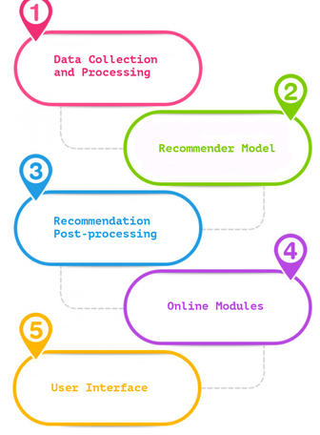
Filtering Algorithm Component
Figure 1: Components of Recommender

Slide 9
Collaborative Filtering Algorithm
Collaborative Filtering Algorithm aggregate ratings or recommendations of objects, recognize commonalities between the users on the basis of their ratings, and generate new recommendations based on inter-user comparisons.
collaborative filtering is especially successful in generating personalized recommendations
Types of Collaborative Filtering Algorithm
Memory base
Model base
hybrid

Slide 10
METHODOLODY
The server resources concurrently with little effort to wait and at the same time expecting the best of all result, the needs for effective search result cannot be take likely in other to keep traffic.
This research adopts a collaborative filtering approach from several set of specify database data related to the user desire.
The procedure involves in achieving the Collaborative Filtering Algorithm is a simple analogy of using several means to achieve something better than good result under different circumstances base on the environment requirement.

Slide 11
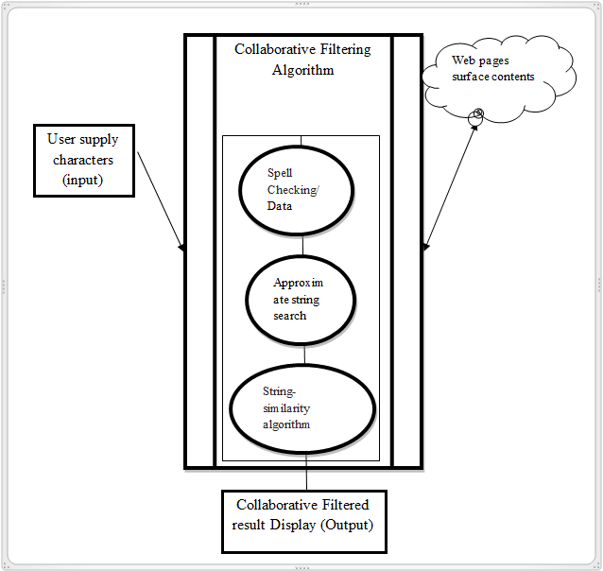
System Data Flow Design
Figure 2: Data flow designs

Slide 12
Summary
Collaborative Filtering Algorithm is a recommender system for filtering unnecessary contents out of vast useful or un useful data based on past information gathered using an efficient search algorithm in other to predict users need.
Collaborative filtering is a method of making automatic predictions (filtering) about the interests of a user by collecting preferences or taste information from many users (collaborating).
The procedure involves in achieving the Collaborative Filtering Algorithm is a simple analogy of using several means to achieve something better than good result under different circumstances base on the environment requirement

Slide 13
References
Alexander Felfernig, Klaus Isak, Kalman Szabo, Peter Zachar, The VITA Financial Services Sales Support, in AAAI/IAAI 2007, pp. 1692-1699, Vancouver, Canada, 2012.
Elahi (https://www.linkedin.com/in/mehdielahi), Mehdi; Ricci, Francesco; Rubens, Neil. A survey of active learning in collaborative filtering recommender systems . Computer Science Review, 2016, Elsevier.
Francesco Ricci and Lior Rokach and Bracha Shapira, Introduction to Recommender Systems Handbook, Springer, 2011, pp. 1-35
H. Chen, A. G. Ororbia II, C. L. Giles ExpertSeer: a Keyphrase Based Expert Recommender for Digital Libraries, in arXiv preprint 2015
Hosein Jafarkarimi; A.T.H. Sim and R. Saadatdoost A Naïve Recommendation Model for Large Databases, International Journal of Information and Education in ACM/IEEE Joint Conference on Digital Libraries (JCDL) 2011

Slide 14
Appreciation
THANK YOU

